Slide 1
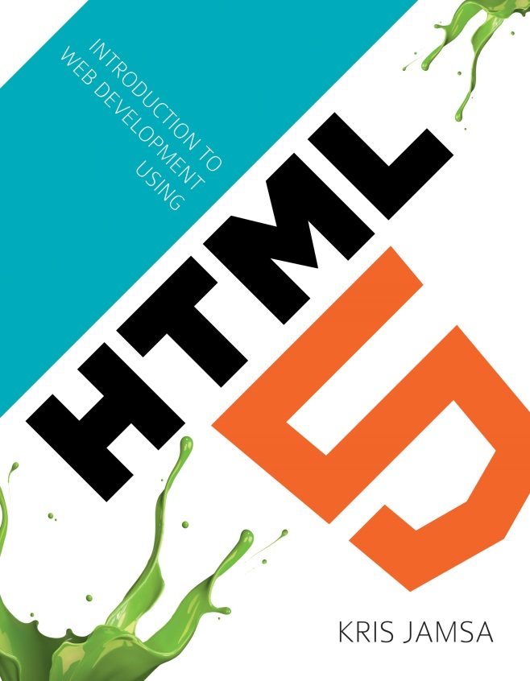
Chapter 11
Using the Document Object Model

Slide 2
Learning Objectives
How by using events such as mouseover or mouseout, your pages can respond to specific user mouse operations
How using an object’s innerHTML attribute allows you to access the nested HTML tags because many HTML tags enclose other HTML tags
How using the Window object allows you to use JavaScript code within your page to access specifics about the current window, such as its size or relative screen position
How using the Navigator object allows you to use JavaScript code to determine the Web browser that is displaying the page contents
How using the Screen object allows you to use JavaScript code within your page to determine specifics about the current screen resolution
How using the Location object allows you to use JavaScript code within your page to determine specifics about the current web-page, such as its URL, file path, or query string

Slide 3
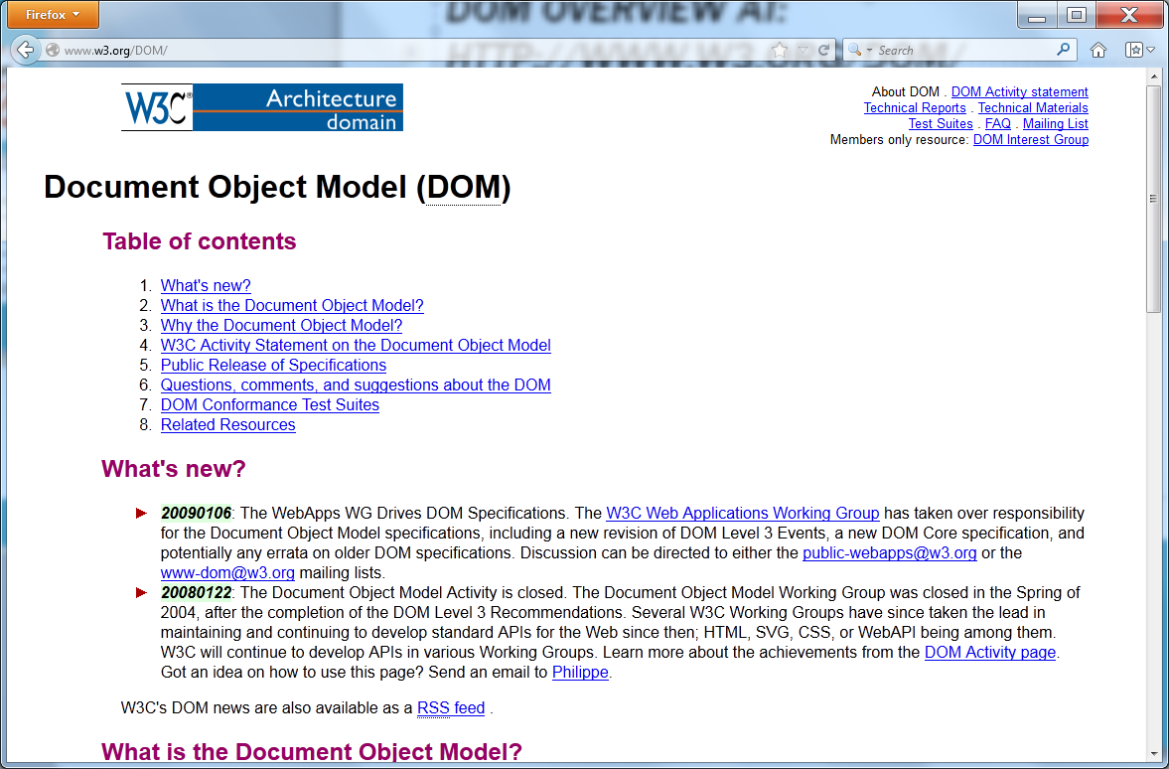
DOM Overview at: http://www.w3.org/DOM/

Slide 4
Understanding objects
An object, in the simplest sense, is a “thing.” With respect to an HTML page, an object might be a paragraph, image, or table. All things have attributes, and the same is true for DOM objects. A paragraph, for example, has related text; an image has a corresponding source URL; and a table might have a height and a width.
In addition to attributes, the browser associates different events with objects, such as a mouse entering a table, hovering over an image, and so on. The sections that follow use different JavaScript functions to leverage object attributes and in the process change a webpage’s behavior.

Slide 5
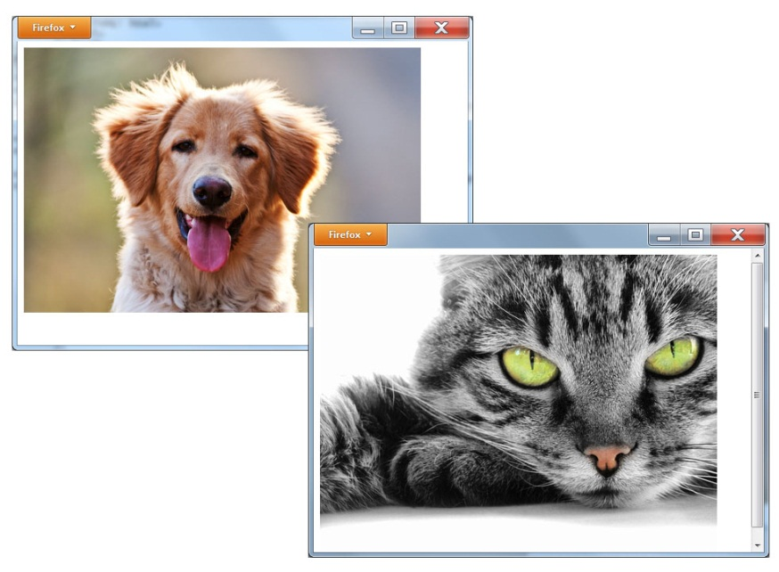
Using DOM to change an image
<DOCTYPE! html> <html> <head> <script> function imageDog() { var ImageObject = document.getElementById("DogCat"); ImageObject.src = "http://www.websitedevelopmentbook.com/Chapter11/Dog.jpg"; } function imageCat() { var ImageObject = document.getElementById("DogCat"); ImageObject.src = "http://www.websitedevelopmentbook.com/Chapter11/Cat.jpg"; } </script> </head> <body> <img id="DogCat" onmouseover="imageCat()" onmouseout="imageDog()" src="http://www.websitedevelopmentbook.com/Chapter11/Dog.jpg" > </body> </html>

Slide 6
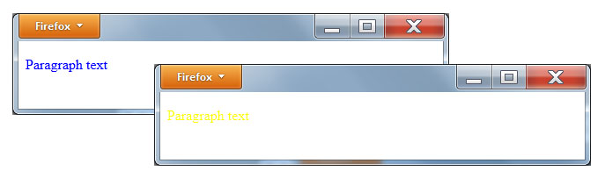
Using dom to change text colors
<DOCTYPE! html> <html> <head> <script> function greenText() { var paragraphObject = document.getElementById("Paragraph"); paragraphObject.style.color = 'yellow'; } function blueText() { var paragraphObject = document.getElementById("Paragraph"); paragraphObject.style.color = 'blue'; } </script> </head> <body> <p id="Paragraph" style="color:blue" onmouseover="greenText()" onmouseout="blueText()"> Paragraph text </p> </body> </html>

Slide 7
Detecting a window-resize event
<DOCTYPE! html> <html> <body onresize="alert('Resize Operation')"> <img src="http://www.websitedevelopmentbook.com/Chapter11/dog.jpg" id="Dog"> </body> </html>

Slide 8
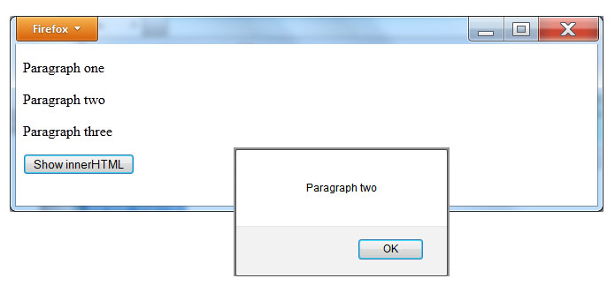
Accessing an element’s innerhtml
<DOCTYPE! html> <html> <body> <p>Paragraph one</p> <p id="middleParagraph">Paragraph two</p> <p>Paragraph three</p> <button onclick="alert(document.getElementById('middleParagraph').innerHTML);"> Show innerHTML </button> </body> </html>

Slide 9
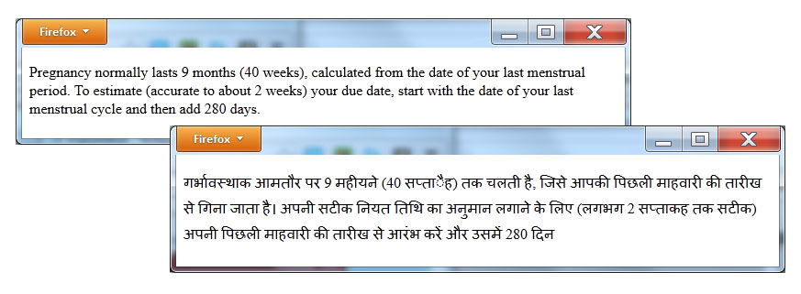
Changing an element’s innerhtml
<DOCTYPE! html> <html> <script> function toHindi() { var paragraphObject = document.getElementById("Paragraph"); paragraphObject.innerHTML = "गर्भावस्थाक आमतौर पर 9 महीयने (40 सप्ताैह) तक चलती है, जिसे आपकी पिछली माहवारी की तारीख से गिना जाता है। अपनी सटीक नियत तिथि का अनुमान लगाने के लिए (लगभग 2 सप्ताकह तक सटीक) अपनी पिछली माहवारी की तारीख से आरंभ करें और उसमें 280 दिन"; } function toEnglish() { var paragraphObject = document.getElementById("Paragraph"); paragraphObject.innerHTML = "Pregnancy normally lasts 9 months (40 weeks), calculated from the date of your last menstrual period. To estimate (accurate to about 2 weeks) your due date, start with the date of your last menstrual cycle and then add 280 days."; } </script> <body> <p id="Paragraph" onmouseover="toHindi()" onmouseout="toEnglish()">Pregnancy normally lasts 9 months (40 weeks), calculated from the date of your last menstrual period. To estimate (accurate to about 2 weeks) your due date, start with the date of your last menstrual cycle and then add 280 days.</p> </body> </html>

Slide 10
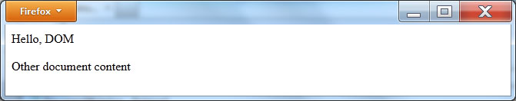
Writing content to the current document
<DOCTYPE! html> <html> <body> <script> document.writeln("Hello, DOM"); </script> <p>Other document content</p> </body> </html>

Slide 11
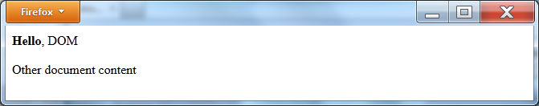
Writing html to the current document
<DOCTYPE! html> <html> <body> <script> document.writeln("<b>Hello</b>, DOM"); </script> <p>Other document content</p> </body> </html>

Slide 12
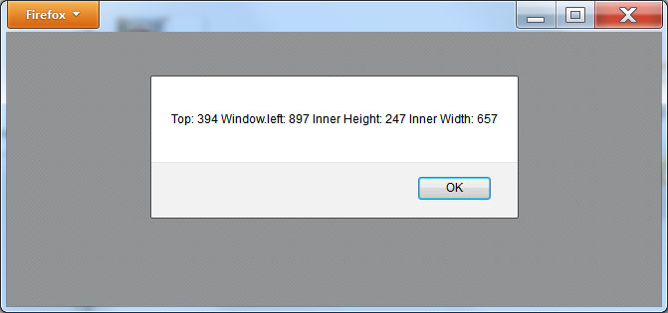
Displaying window specifics
<DOCTYPE! html> <html> <body> <script> alert("Top: " + window.screenY + " Window.left: " + window.screenX + " Inner Height: " + window.innerHeight + " Inner Width: " + window.innerWidth); </script> </body> </html>

Slide 13
Printing the current window’s contents
<DOCTYPE! html> <html> <body> <img src="http://www.websitedevelopmentbook.com/Chapter11/Dog.jpg" > <br/> <button onclick="window.print()">Print Window</button> </body> </html>

Slide 14
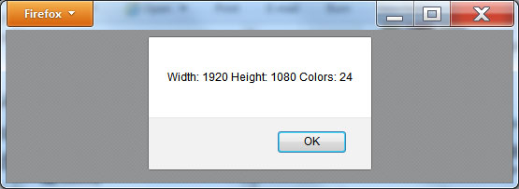
Displaying screen specifics
<DOCTYPE! html> <html> <body> <script> alert("Width: " + screen.width + " Height: " + screen.height + " Colors: " + screen.colorDepth); </script> </body> </html>

Slide 15
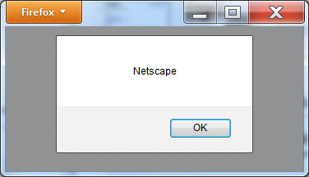
Displaying the current browser name
<DOCTYPE! html> <html> <body> <script> alert(navigator.appName); </script> </body> </html>

Slide 16
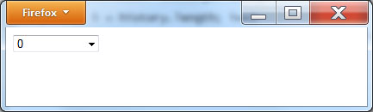
Using the history object
<DOCTYPE! html> <html> <head> <script> function changeContent() { var value = document.getElementById('PullDown').value; history.go(value); } </script> </head> <body> <select id="PullDown" onchange="changeContent();"style="width:100;"> <script> for (i = 0; i < history.length; i++) { document.writeln("<option value=" + i + ">" + i + "</option>"); } </script> <select> </body> </html>

Slide 17
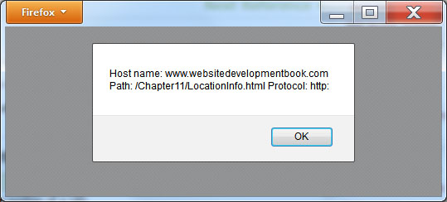
Displaying current page information
<DOCTYPE! html> <html> <body> <script> alert("Host name: " + location.host + " Path: " + location.pathname + " Protocol: " + location.protocol); </script> </body> </html>

Slide 18
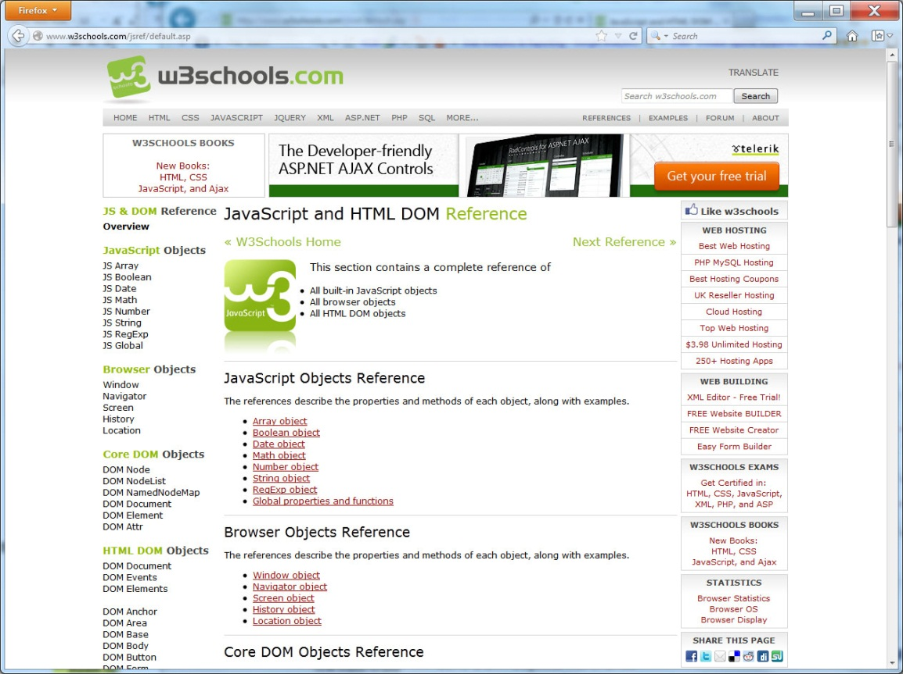
Real world: w3Schools

Slide 19
Summary
To render a webpage, a browser treats the elements that make up the page, such as paragraphs, headings, images, lists, tables, and so, as objects.
In the simplest sense, an object is a thing consisting of attributes, events, and operations. One object may be a paragraph, one an image, one a table, and so on.
To access such objects within a webpage, browsers use the Document Object Model, or DOM. This chapter introduced the Document Object Model.
Using JavaScript within your webpage, you can use DOM to access individual page components to create dynamic page content that your page can change based on operations the user performs.
You can also use DOM objects to perform key operations, such as validating a form’s contents.

